Slide 1


Tiki
Inventory
Processing
System

Slide 2
Table of content
1. Inventory
3. Consistency
2. Architecture
Model
Problems
4. Processing
5. Checkout
6. Warehouse
Model
Integration
Integration

Slide 3
1.Inventory Problems
THE CONSISTENCY DATA OF INVENTORY
The data of inventory is required high consistency.How to scale but guarantee the consistency of data is the most challenging problem of the inventory system
THE COMPLEXITY OF INTEGRATION WITH OTHER SYSTEMS
The number quantify of a product is very important for all operations. So the inventory system has to integrate with other systems, especially with checkout and warehouse systems deeply. The data flow is long, comes from the warehouse, through checkout, order, and delivery. If the data is missing at any step, it can break the system, and hard to trace the inconsistency

Slide 4



2.Architecture
-Guarantee the eventual consistency of the inventory data
-Using a Single thread-based model and local memory but must handle a large volume of traffic

Slide 5
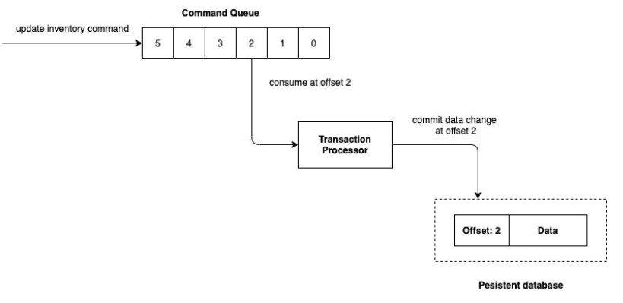


3. Consistency Model

Slide 6
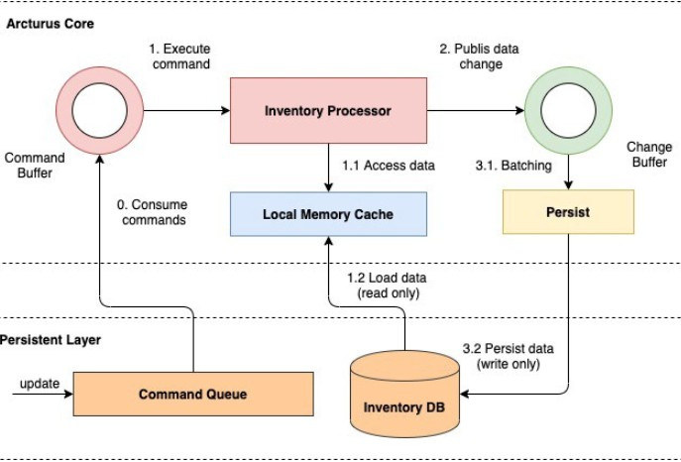
4. Processing Model

Slide 7
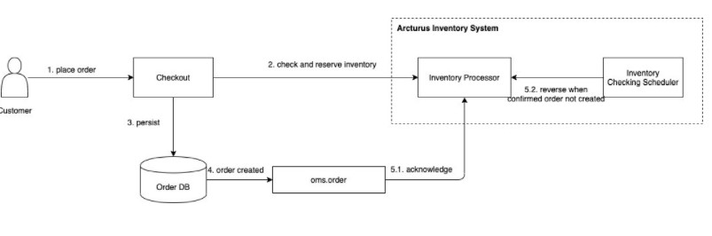

5. Checkout Integration

Slide 8
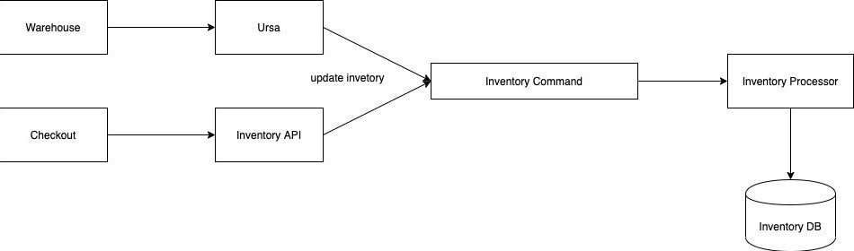
6. Warehouse Integration

Slide 9
Thank you!
DO YOU HAVE ANY QUESTIONS FOR ME?

